Slide 1

ANALYSIS
Presented By Group 4

Slide 2



Meet our team
Mr. Abhipray Pundge
Ms. Nikita Krushna Mendhe
Mr. Aman Aggarwal
Mr. Sagar Rajeshwar Jogu

Slide 3
Agenda
Introduction
Overview
KPI’s
Insights And Recommendation
Conclusion

Slide 4
Introduction
The Olist Store Analysis project will involve exploring the different aspects of the e-commerce domain. Through this olist store analysis project, we hope to uncover valuable insights that can contribute to better decision making, operational efficiency, customer satisfaction.

Slide 5




Language Tool Used

Slide 6
Overview
In this presentation, we will explore key performance indicators (KPIs) that provide insights into Olist Store's operations, customer behavior, and overall effectiveness. Our focus will be on understanding various aspects of order patterns, payment methods, delivery performance, and customer satisfaction. By analyzing these KPIs, we aim to uncover actionable insights that can drive improvements and optimize our strategies.

Slide 7
KPI’s
1
2
3
4
5
Weekdays and Weekend Payment statistics
Payment type with review score 5
Average number of delivery days taken for pet shop
Average price and payment value of sao paulo city
Relationship between average shipping day and review score

Slide 8
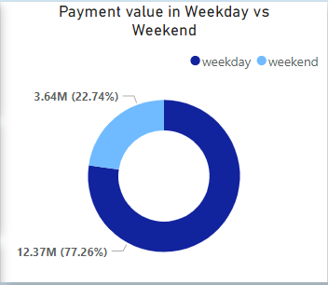
KPI-1
Weekdays and Weekend Payment Statistics
The donut chart shows the distribution of payment values between weekdays and weekends.
Weekdays account for 77.26% of the payment value, totaling 12.37M.Weekends account for 22.74% of the payment value, totaling 3.64M.
There is significantly higher e-commerce activity during weekdays compared to weekends.
Comparing the total payment values helps identify which period contributes more significantly to overall revenue. Higher totals on specific days can indicate peak revenue periods.

Slide 9
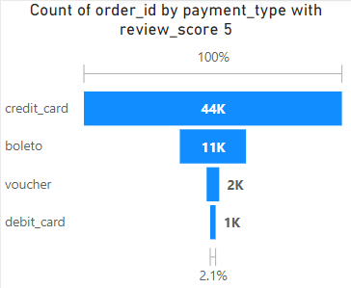
KPI-2
Payment type with review score 5
This KPI quantifies the number of orders that received a perfect review score of 5 and were paid using a credit card.
A large majority of the top-rated transactions are completed with credit cards. This could indicate that credit card users have a better overall shopping experience, possibly due to convenience, rewards, or better customer service.
Provides insight into the payment preferences of customers who are extremely satisfied with their purchase experience

Slide 10
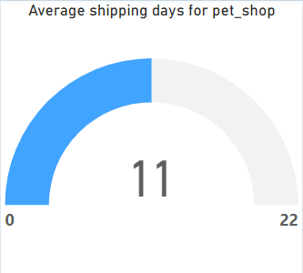
KPI-3
Average number of delivery days taken for pet shop
This KPI calculates the average time taken from the order purchase date to the delivery date specifically for orders from the pet shop
Measures how efficiently the pet shop fulfills and delivers orders.
Assesses the typical delivery time customers experience, which can impact overall satisfaction.

Slide 11
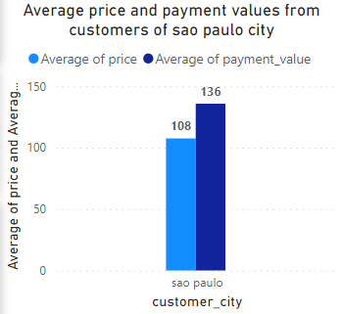
KPI-4
Average price and payment value of sao paulo city
This KPI measures the average price of orders and payment values from customers located in Sao Paulo City.
Helps understand spending trends in Sao Paulo, potentially guiding product offerings and promotional strategies tailored to this city's market.
The KPI for average price and payment value of Sao Paulo City customers provides valuable insights into purchasing behavior and financial performance. By analyzing these metrics, businesses can refine their pricing strategies, tailor marketing efforts, and enhance overall revenue management in Sao Paulo City.

Slide 12
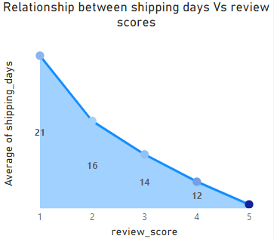
KPI-5
Relationship between average shipping day and review score
This KPI analyzes the correlation between the number of days taken for shipping (delivery time) and the review scores provided by customers.
Examines how delivery times impact customer satisfaction as reflected in review scores.
Identifies if faster or slower delivery times correlate with higher or lower review scores, providing insights into the relationship between delivery performance and customer feedback.

Slide 13
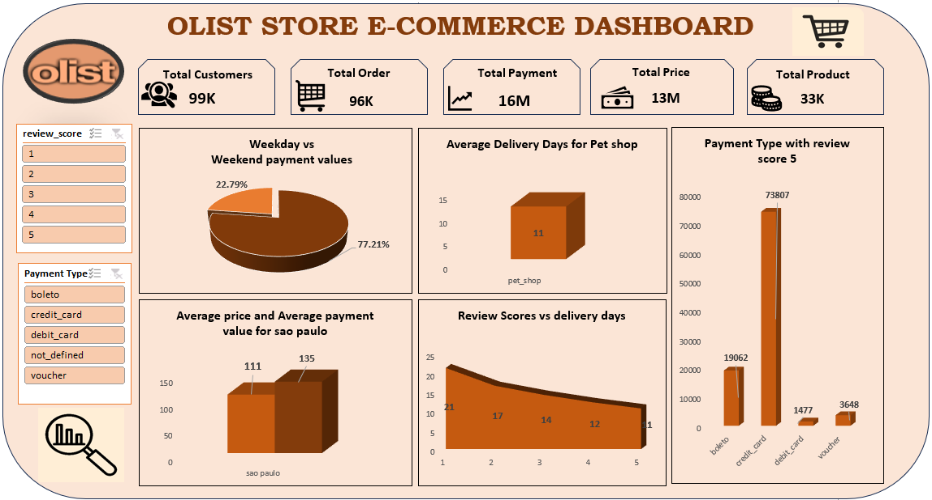
Excel Dashboard

Slide 14
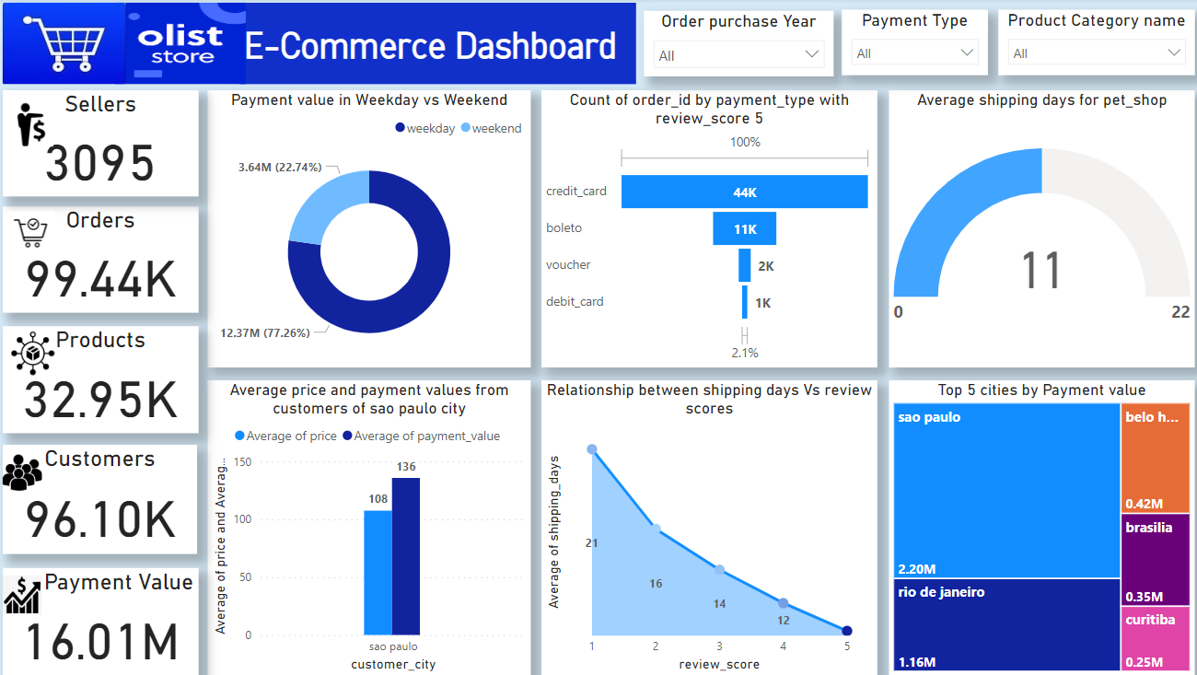
Power BI Dashboard

Slide 15
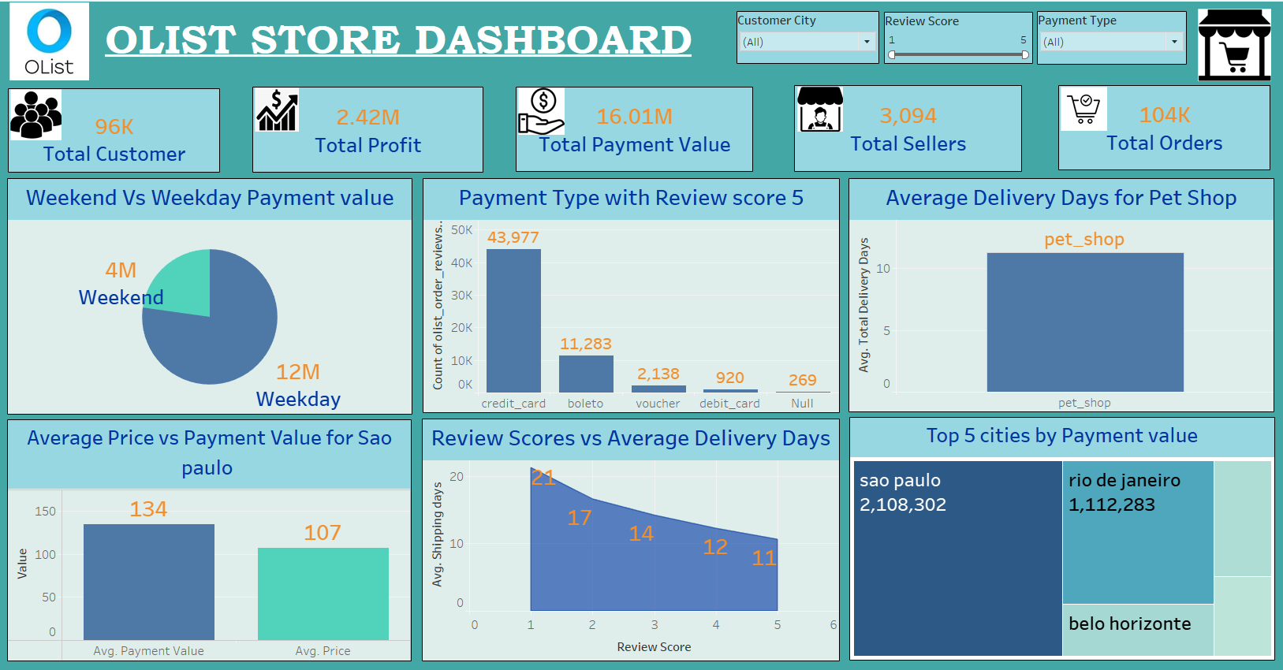
Tableau Dashboard

Slide 16
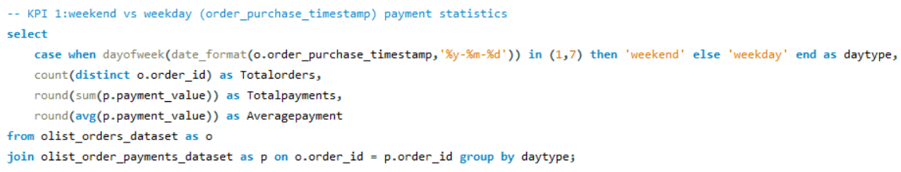
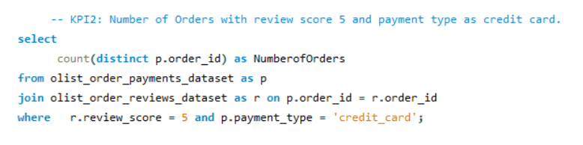
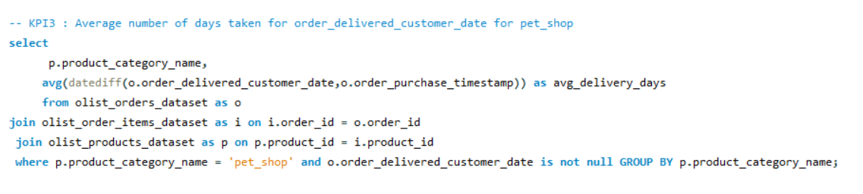
MySQL Workbench

Slide 17
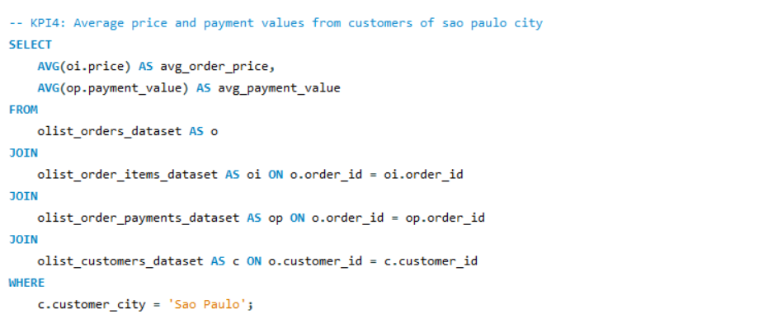
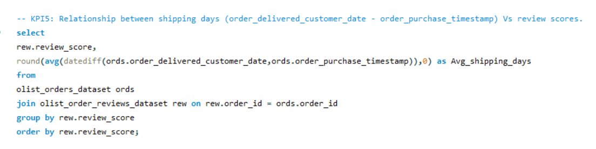

Slide 18
Insights
According to the data, Olist E-commerce has about 99,440 orders. With about 89,940 orders being delivered, the company has a 90% delivery success rate.
Analyzing total payment values for weekdays versus weekends provides a clear picture of revenue distribution and consumer behavior. These insights enable businesses to make data-driven decisions to enhance financial performance and optimize operational strategies.
Number of Orders with Review Score 5 and Payment Type provides an understanding of how often high-rated orders are associated with credit card payments, which can be used to evaluate the impact of payment methods on customer satisfaction. This may suggest that credit card payments are associated with a positive purchasing experience, or it might reflect credit card usage patterns among your most satisfied customers.

Slide 19
Average Number of Days Taken for Order Delivery for Pet Shop provides insights into delivery performance and helps in identifying areas for improvement in the order fulfillment process.
Comparing the average price and average payment value provides a comprehensive view of customer spending. If these metrics are closely aligned, it indicates consistency in customer spending behavior. Significant discrepancies might suggest differences in pricing strategy versus actual payment patterns.
Relationship between average shipping day and review score provides valuable information on how delivery speed affects customer satisfaction. A strong correlation between faster shipping and higher review scores indicates that quicker delivery enhances customer satisfaction.

Slide 20
Recommendations
Weekday vs. Weekend: Implement targeted promotions, optimize staffing, and analyze purchase patterns to balance sales and improve revenue distribution.
Orders with Review Score 5 and Credit Card: Credit cards lead to higher satisfaction, indicating a potential focus on credit card payment optimizations and related customer service.
Average Delivery Time for Pet Shop: If the average delivery time is longer than desired, this indicates a need to streamline logistics and improve delivery processes to enhance customer satisfaction and reduce any potential negative feedback.
Average Price and Payment Values in São Paulo: Localize marketing efforts, adjust pricing strategies, and offer promotions tailored to Sao Paulo customers.
Shipping Days vs. Review Scores: Focus on reducing delivery times, monitor the impact on reviews, and enhance logistics to improve customer satisfaction and review scores.

Slide 21
Conclusion
These KPIs provide a comprehensive view of payment behaviors, customer satisfaction, and operational performance. By analyzing and understanding these metrics, businesses can make data-driven decisions to improve customer experiences, optimize revenue generation, and enhance overall operational efficiency. Implementing insights from these KPIs can lead to more effective marketing strategies, better customer service, and increased business success.
As a data analyst, we have used Excel and Power BI to clean and manipulate the dataset and create meaningful visualizations. This project serves as a great example of how data analysis can help businesses make informed decisions.

Slide 22


